Slide 1


LEADERSHIP STRATEGIES
Department of Computer Science
Instructor Name: Ms. Maryam Farooq
University of Engineering and Technology
Notes:
These lecture of CS-Leadership Strategies Course that is requirement of Computer Science Degree Program

Slide 2
Chapter Eight Influence Tactics of Leaders Lec 3 ,Week#9
LEADERSHIP
Andrew J. DuBrin, 7th Edition

Slide 3
Learning Objectives
Describe the relationship between power and influence.
Identify a set of honest and ethical influence tactics.
Identify a set of influence tactics relatively neutral with respect to ethics and honesty.
Identify a set of dishonest and unethical influence tactics.
Summarize some empirical research about the effectiveness and sequencing of influence tactics.
Describe how implicit leadership theories are related to a leader’s ability to influence group members.

Slide 4
Sequencing of Influence Tactics
Sequencing of Influence Tactics
In general, begin with the most positive, or least abrasive, tactic.
Proceed to stronger tactics to gain advantage being sought.
Also, begin with the low-cost, low-risk tactics.

Slide 5
Sequencing of Influence Tactics
Sequencing of Influence Tactics
In general, begin with the most positive, or least abrasive, tactic.
Proceed to stronger tactics to gain advantage being sought.
Also, begin with the low-cost, low-risk tactics.

Slide 6
Implicit Leadership Theories & Leadership Influence
People are more likely to be influenced by leaders who match their expectations of what a leader should be.
Implicit leadership theories are personal assumptions about the traits and abilities that characterize an ideal organizational leader. As we enter the workplace, these assumptions are activated as group members interact with leaders.
Prototypes are positive characterizations of a leader.
Antiprototypes are traits and abilities group members do not want to see in a leader.
Implication is a leader who fits group members’ prototypes are more likely to influence them than a leader who fits their antiprototypes.

Slide 7
Implicit Leadership Theories & Leadership Influence
People are more likely to be influenced by leaders who match their expectations of what a leader should be.
Implicit leadership theories are personal assumptions about the traits and abilities that characterize an ideal organizational leader. As we enter the workplace, these assumptions are activated as group members interact with leaders.
Prototypes are positive characterizations of a leader.
Antiprototypes are traits and abilities group members do not want to see in a leader.
Implication is a leader who fits group members’ prototypes are more likely to influence them than a leader who fits their antiprototypes.

Slide 8
Implicit Leadership Theories & Leadership Influence
People are more likely to be influenced by leaders who match their expectations of what a leader should be.
Implicit leadership theories are personal assumptions about the traits and abilities that characterize an ideal organizational leader. As we enter the workplace, these assumptions are activated as group members interact with leaders.
Prototypes are positive characterizations of a leader.
Antiprototypes are traits and abilities group members do not want to see in a leader.
Implication is a leader who fits group members’ prototypes are more likely to influence them than a leader who fits their antiprototypes.

Slide 9
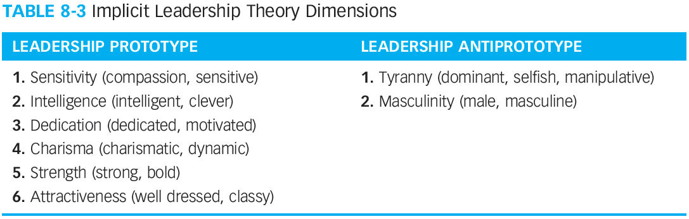
Implicit Leadership Theory Dimensions

Slide 10
Summary
Influence is the ability to affect the behaviors of others in a particular direction.
Power is the potential or capacity to influence.
A leader’s influence outcomes of commitment, compliance, or resistance are a function of the influence tactics used.
Some influence tactics are ethical; some are neutral; some are unethical.
The most effective influence tactics are rational persuasion, inspirational appeal, and consultation.
The least effective influence tactics are pressure, coalition, and appealing to legitimate authority.
The sequencing and direction of influence tactics is important.
Implicit leadership theories are personal assumptions about the traits and abilities which characterize an ideal organizational leader.

Slide 11
“The key to successful leadership today is influence, not authority.” ~ Kenneth Blanchard.

Slide 12
Jazak Allah Khair

